Slide 1

Project Labor Agreement/Construction Careers Policy & Manufacturing Careers Policy

Slide 2

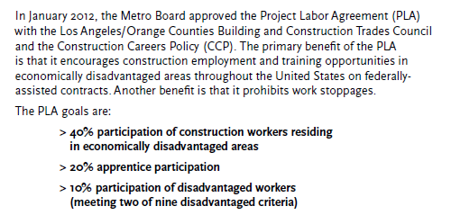
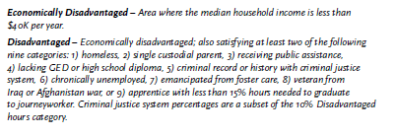
Project Labor Agreement/Construction Careers Policy Overview

Slide 3
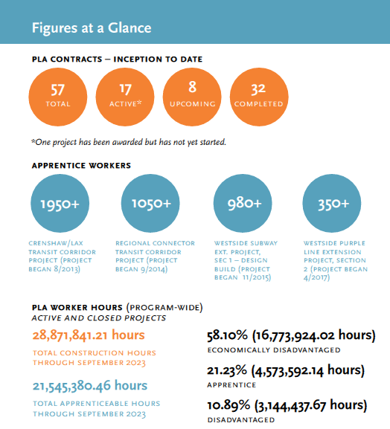
PLA/CCP Program Achievements

Slide 4
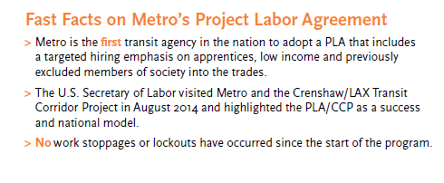
PLA/CCP Program Achievements
>$542 Million paid to Targeted Workers (September 2023) *
    >$101 Million paid to Disadvantaged Workers *
    >$147 Million paid to Apprentice Workers**
Exceeded Targeted/Apprentice/Disadvantaged Worker Goals
(*Based on the lowest laborers' rate as of June 2017)
(**Based on the lowest apprentice rate as of January 2017)
(Workers may fall into multiple categories)

Slide 5
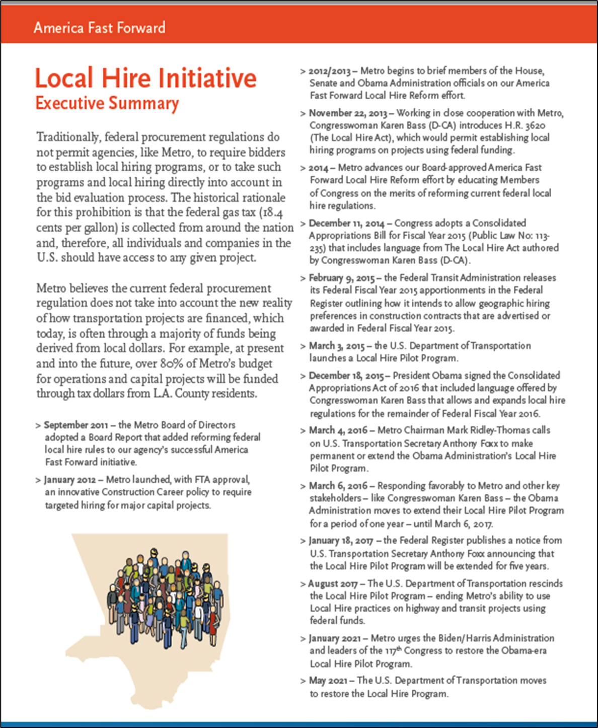
PLA/CCP Local Hire
Ten construction projects subject to Local Hire
Over $2.8B worth of construction contracts subject to Local Hire
Eight construction projects are exceeding the Local Hire requirement as of
September 2023

Slide 6
Manufacturing Careers Policy Overview
Manufacturing Careers Policy (MCP) establish the internal guidelines for the US Employment Program (USEP) and Local Employment Program (LEP). The objective of the MCP is to maximize the economic co-benefits from investments in transit equipment, infrastructure, and related services.
U.S. Employment Plan (USEP) sets-forth specific commitments for creating employment opportunities in the United States in connection with Rolling Stock procurements. USEP is applicable to all of Metro’s federally funded rolling stock procurements and related contracts with a minimum contract value of $50 million.
Local Employment Plan (LEP) is a program to include local/geographic based hiring preference and economic-based labor hiring preferences on locally funded Rolling Stock procurements.

Slide 7
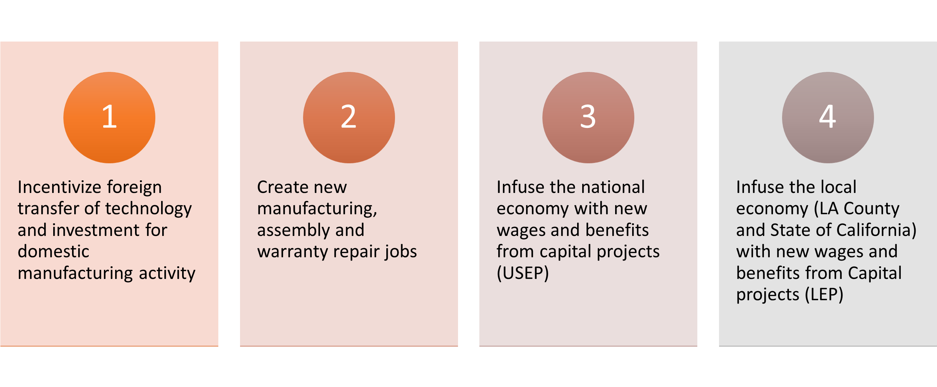
United States Employment Plan……Goals

Slide 8

United States Employment Plan/Local Employment Program Commitments
7 Rolling Stock Contracts subject to USEP/LEP program
  Over $20 million of wages & benefit allocated to USEP/LEP program on base contracts.
  Additional amount of over $25 million of wages & benefits on option years (if exercised).
  Over $14 million investment for local facility investment
  Disadvantaged hiring commitments

Slide 9
United States Employment Plan/Local Employment Program Commitments
7 Rolling Stock Contracts subject to USEP/LEP program
  Over $20 million of wages & benefit allocated to USEP/LEP program on base contracts.
  Additional amount of over $25 million of wages & benefits on option years (if exercised).
  Over $14 million investment for local facility investment
  Disadvantaged hiring commitments

