Slide 1
Leveraging CA’s Procurement to Create Equity & High Quality Jobs
Jobs to Move America
February 26, 2024

Slide 2
Goals of SB 150
Create equity & high road, unionized manufacturing jobs in clean technology and infrastructure industries
Build up communities
Foster access to good jobs for marginalized communities
Increase transparency
We can accomplish this through:
Public procurement
Loans and subsidies
SB 150: HIGH QUALITY JOBS AND TRAINING
FEBRUARY 26, 2024
June 14, 2022

Slide 3
SB 150 Process
Concerns
Exclusive
Lack of engagement around the core issue: how do we use CA’s procurement power to achieve equity & high road jobs?
Examples: Hyundai & Tesla
SB 150: HIGH QUALITY JOBS AND TRAINING
FEBRUARY 26, 2024
June 14, 2022

Slide 4
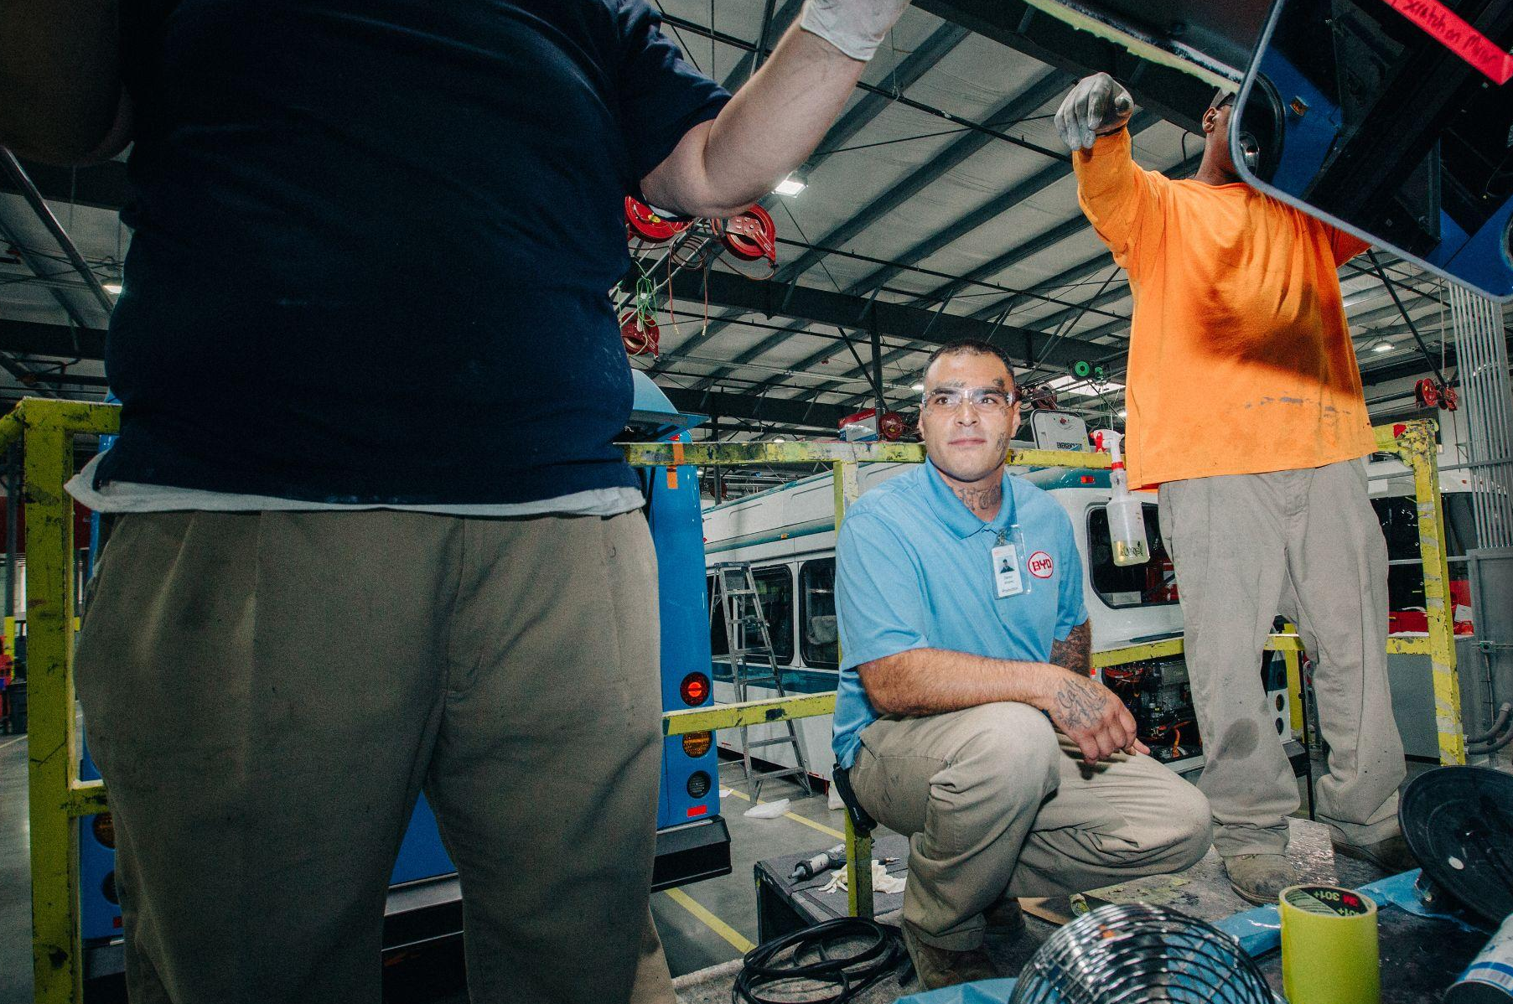
California is Leaving Dollars on the Table
Billions of dollars have been spent without labor standards or equity for jobs
Without state action, billions more will be underutilized
SB 150: HIGH QUALITY JOBS AND TRAINING
FEBRUARY 26, 2024
June 14, 2022

Slide 5
Examples in Existing Policies
Federal Leadership
Department of Energy
Community Benefits Plans
Department of Commerce
Job quality commitments
New Guidance on Federal Funding
We need to systematically embed these tools across California
SB 150: HIGH QUALITY JOBS AND TRAINING
FEBRUARY 26, 2024
June 14, 2022

Slide 6
Using What Works, Removing What Doesn’t
Transparency, not secretive processes
Measurable & specific commitments, not “best efforts”
Systemic policy adoption over a program-by-program approach
SB 150: HIGH QUALITY JOBS AND TRAINING
FEBRUARY 26, 2024
June 14, 2022
June 14, 2022

Slide 7
Thank You
Madeline Janis, Esq
mjanis@jobstomoveamerica.org
Co-Executive Director
Jobs to Move America

